Slide 1
Make the Led Blink!
Intro to Input/output and Programming

Slide 2
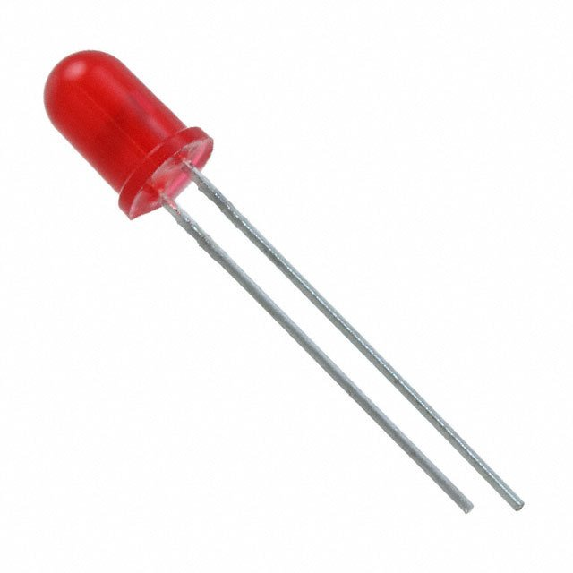
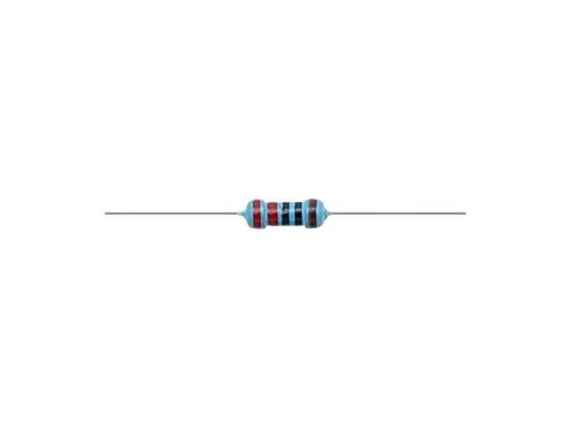
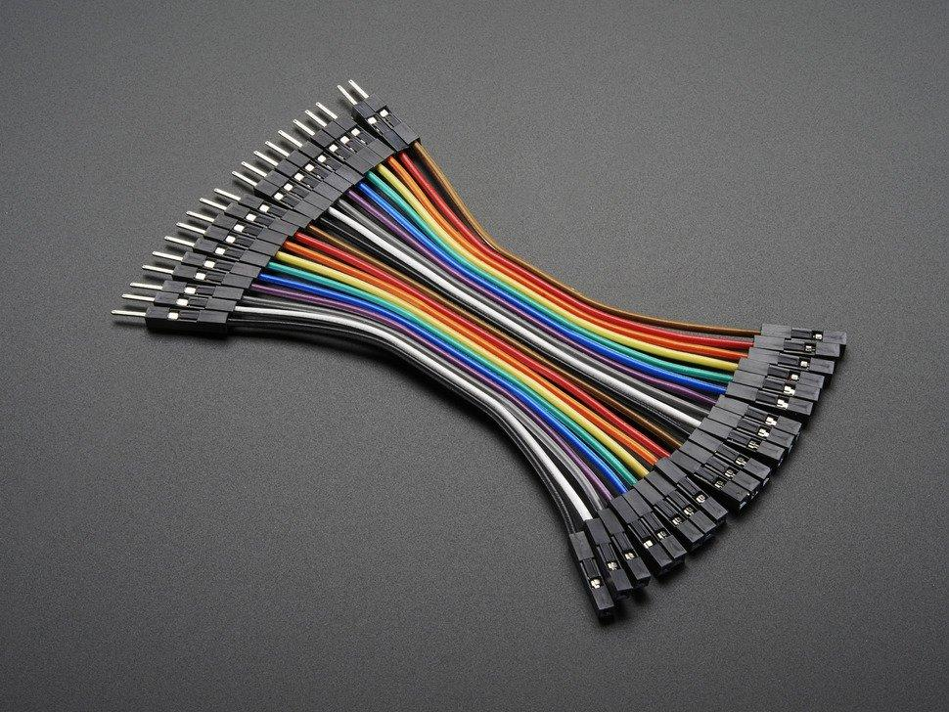
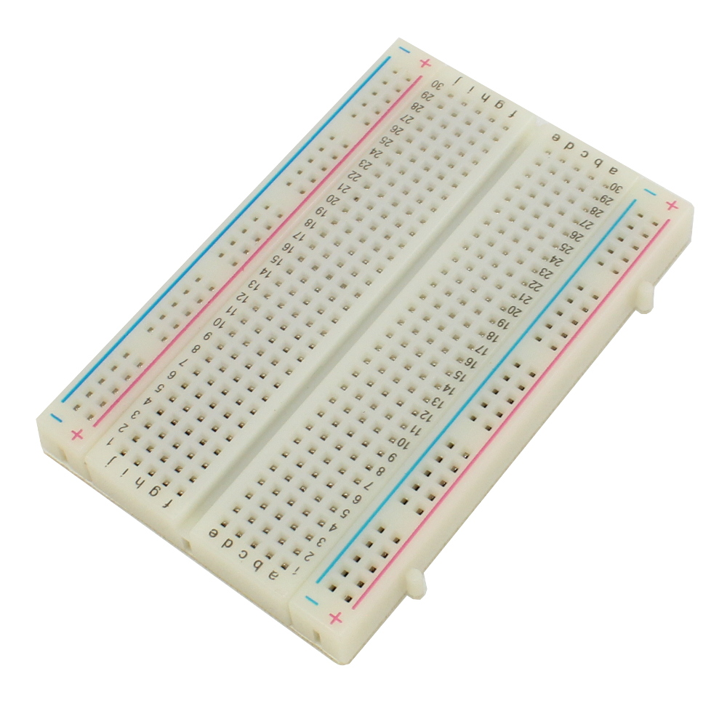
Things you will need
1 Breadboard
1 Raspberry Pi
1 Led
1 Resistor (220 Ohm)
2 Cables (Female to male connectors)
Fasten your seat belts. It is starting to get fun!!

Slide 3
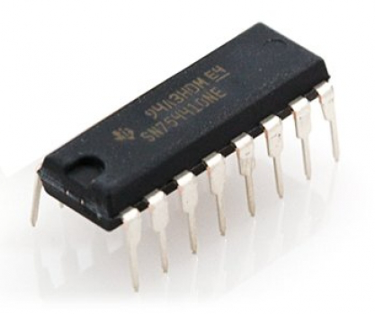
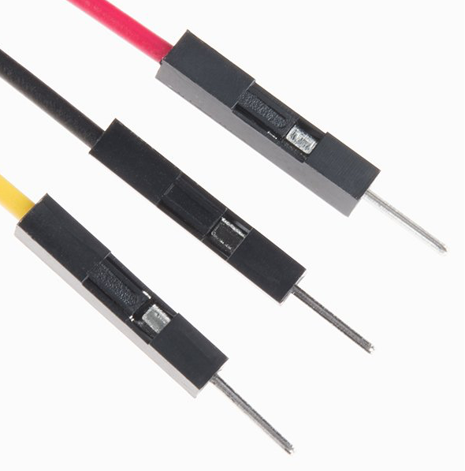
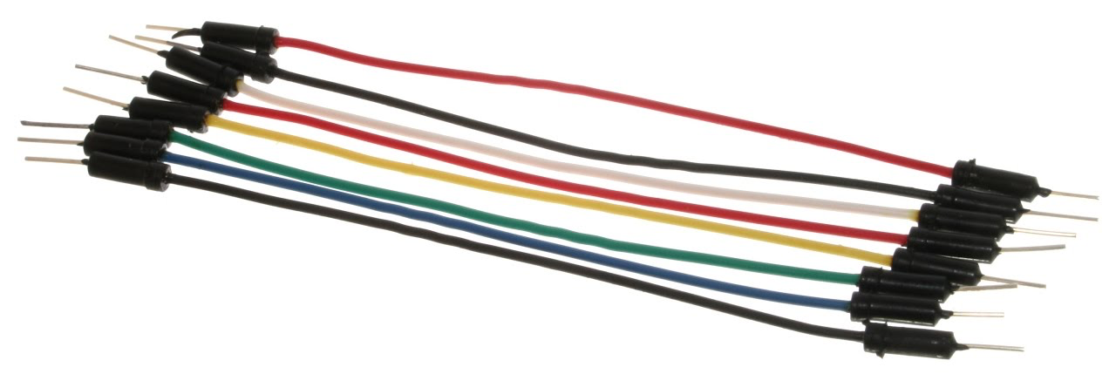
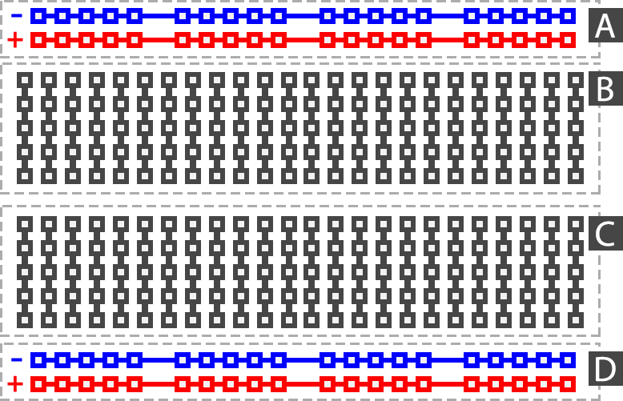
Breadboards
Jumper Wires
Power Rails are connected along the length of the board
The center rows are connected across the board with a break in the center.
Notes:
Breadboards are simple tools that make constructing simple circuits easy. A breadboard is a plastic board with holes in it. When you plug jumper wires, microchips, or other electrical components into a hole they are electrically connected to other components depending on the row and column they are plug into.
Along either of the long sides there are two rails that are connected across the entire length of the board. These are often referred to as power rails, because they are most often used to plug in 5 volt and/or 3.3 volt power supplies to provide electrical current to your circuit. Between the power rails there are connections that run across the board. Each individual row ---or column depending on how you orient the board--- runs across the board with a break in the center, leaving five connected holes on either side of the center break. You can use these connections to connect components and build circuits.

Slide 4
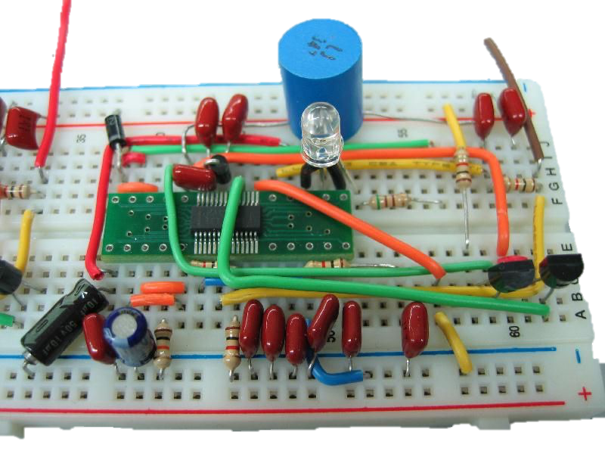
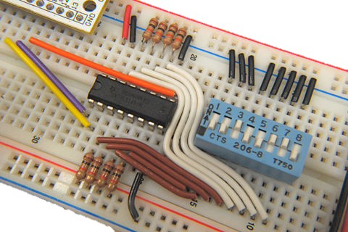
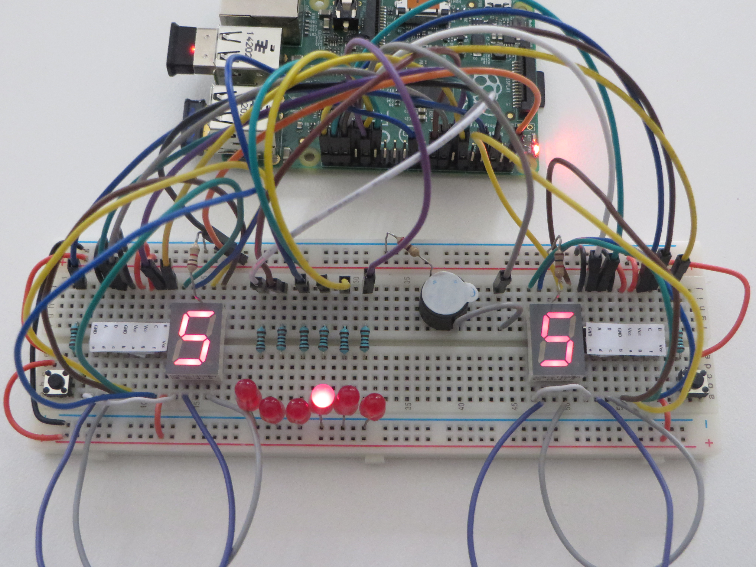
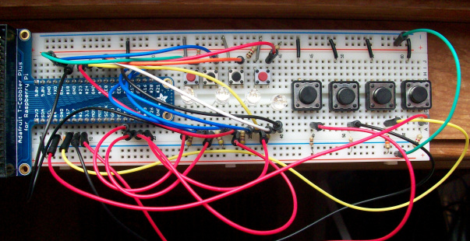
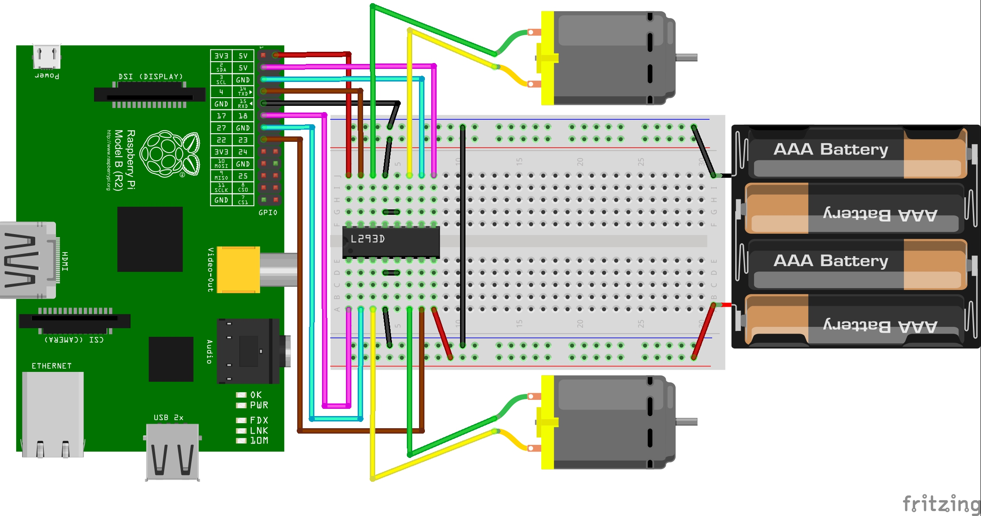
Breadboard Circuits
Notes:
Breadboard circuits can get quite complicated, but the underlying concepts are the same. Study these circuits and see what you can identify. What is connected to what? Note how some microchips and components are place across the break in the center, this means you can connect wires and components to either side of the chip.

Slide 5
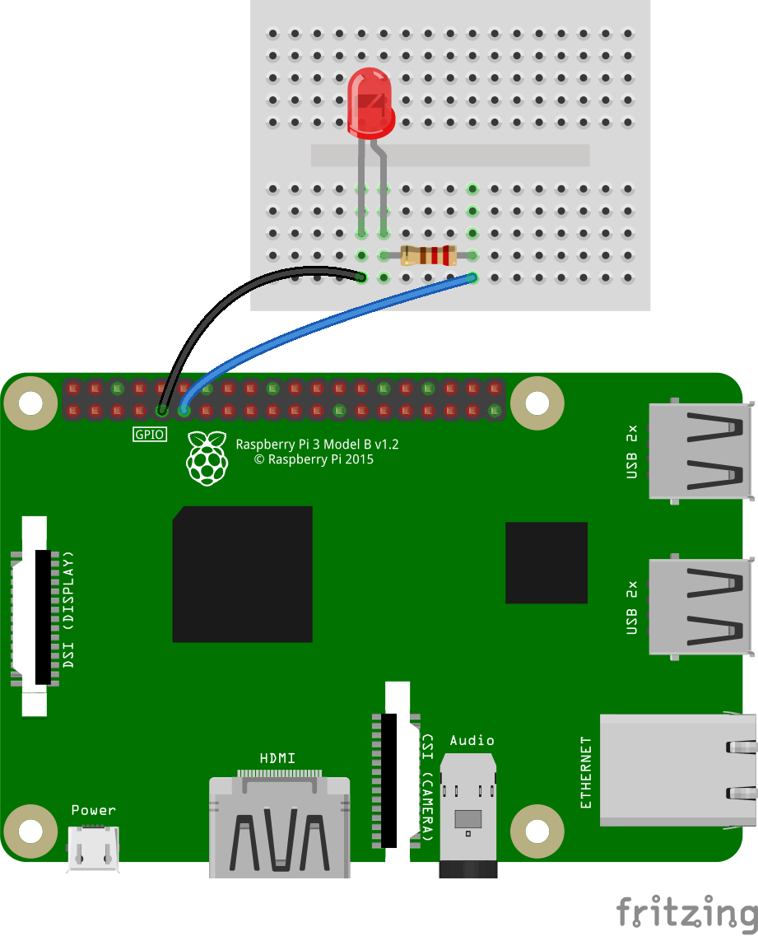
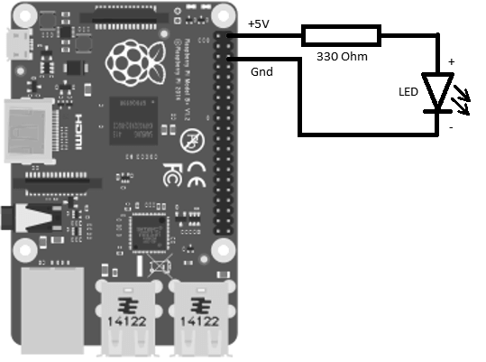
LED Circuit
Notes:
Let’s talk about a an LED circuit. When a GPIO pin is put into a HIGH state it emits a 5 volt current. We need to knock the voltage down a bit so we will use a 330 ohm resistor. Study the diagram on the left. We’ll need to put the 330 ohm resistor in the circuit. The Raspberry Pi GPIO Pins can put out about 60 milliamps of current, but the LED may try to draw more, so we’ll use a resistor to keep it under control. If you look at the diagram on the right you can see that a resistor has been used to connect two columns of connectors. Therefore, the 5 volt current from the GPIO pin will go to the first column cross across the resistor to the second column before entering the LED and returning to the ground pin on the Raspberry Pi to complete the circuit. Think of the current as a water rushing through pipes ---the electrons are attracted to the positive terminal so they flood through the circuit from the negative side to the positive side of the circuit. The resistor restricts the amount of current like a thinner section of pipe that allows less water to move through it.

Slide 6
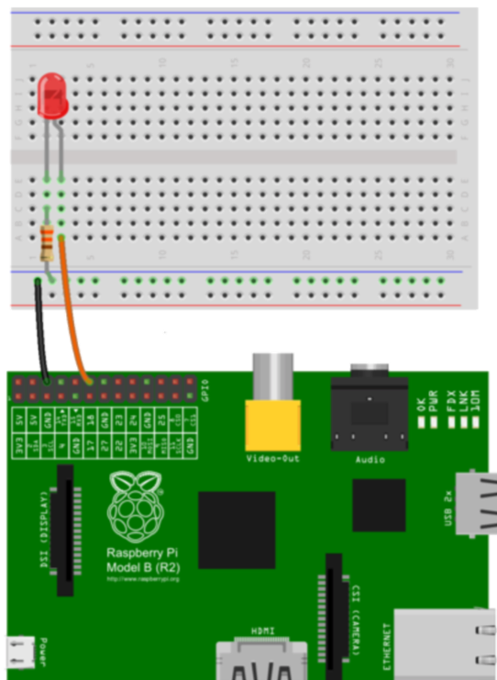
Setting up the circuit
LED: Light Emitting Diode
Longer leg connects to +(ve) power supply
Shorter leg connects to –(ve) power supply
Notes:
Before we dive into the code, we need to setup the circuit. Breadboard allows us to connect electronic components without having to solder them together. In this project, we will be connecting LED to the breadboard. LED stands for Light Emitting Diode, it glows when electricity is passed through. Notice that the Led has one leg longer than another. The longer leg connects to the positive power supply. Shorter leg connects to negative power side of the circuit or ground. Note that if you do not connect LED correctly, it wont light up. You can place the LED in any column on the breadboard. To connect the LED light to the GPIO pin, we need to use resistor(s). Resistors are a way of limiting the amount of electricity going through a circuit. If we do not use the resistor, then it might burn the Pi or the GPIO pins. Note this diagram shows a different way of placing the resistor into the circuit by connecting the column to the ground rail with the resistor.
Check that the circuit is correctly setup.

Slide 7
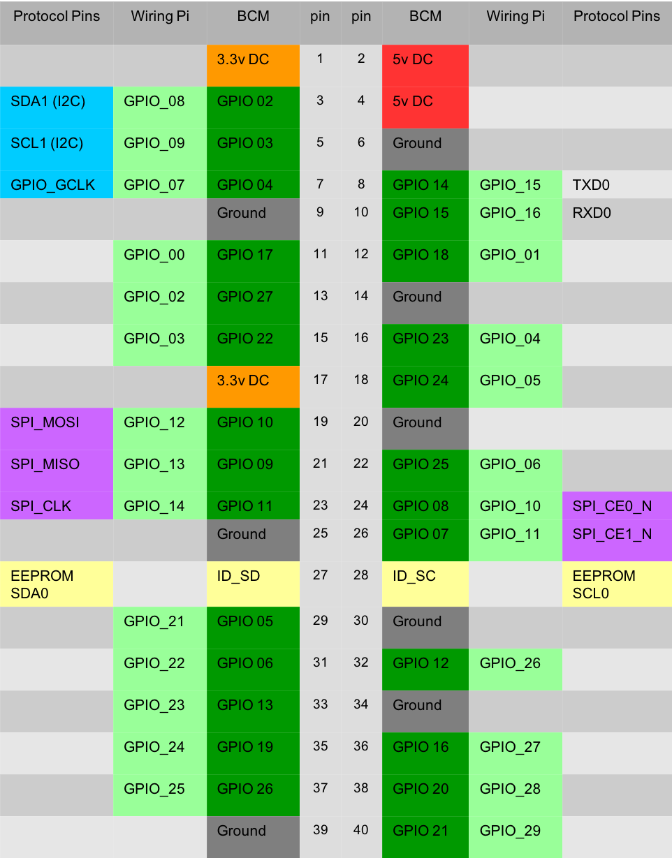
GPIO
General Purpose Input/ Output (26 Pins)
Connect GPIO_4 (BCM) to the positive side of the LED circuit.
Connect a ground pin to the negative side of the LED circuit.
Notes:
The Raspberry Pi has 26 General Purpose Input/Output Pins. GPIO pins are labeled for us. See the picture. First, locate the GPIO Pin 4 and the Ground pins using BCM pin mapping. Connect the pin 4 to the positive side of your circuit and the Ground pin to the negative side of your circuit.

Slide 8
Check Progress
What does LED stand for?
Why do we need resistors?
What are GPIO pins?

Slide 9
Let’s write some code!
Open the Thonny IDE on your RPi
First lets import some stuff we’ll need:
import RPi.GPIO as GPIO
from time import sleep
Notes:
Alright, let’s code! Open Thonny on your Raspberry Pi. Click the Raspberry symbol in the upper left corner of your Raspberry Pi desktop. Select the programming tab and select Thonny. Raspberry Icon🡪Programming🡪Thonny. Click the big plus sign to create a new file. The first thing we need to do is important the library and objects we need. Specifically, we need the GPIO library and the sleep function from the time library.

Slide 10
Coding: Setup
Let’s stop the warnings GPIO:
GPIO.setwarnings(False)
Next set the GPIO mode to BCM:
GPIO.setmode(GPIO.BCM)
Provision the GPIO pin we need:
GPIO.setup(4, GPIO.OUT)
Notes:
Now let’s disable the GPIO warnings, we don’t need them for this project. Write the following line. Now we need to set the GPIO mode. This controls how the pins are numbered. For this program we will use the Broadcom SOC channel numbers. Finally, let’s provision pin 4 as an output pin. We want to operate an external component so we need to set the pin to output.

Slide 11
Coding the program
Let’s turn the GPIO pin on:
GPIO.output(4, GPIO.HIGH)
Now put the program to sleep for a second
sleep(1)
Now we turn it off
GPIO.output(4, GPIO.LOW)
Notes:
Ok, we imported the libraries we will be needing, we setup the pin we will use. Now let’s write the program. Remember, if we set a pin to HIGH it will deliver a small 5 volt current to whatever it is connected to. So let’s use the GPIO.output function to set pin number 4 to HIGH. We’ll use the sleep function to make the program wait for 1 second. Then we will use the GPIO.output function to turn pin 4 to LOW. If everything is done correctly the LED should light up for one second.

Slide 12
Questions?
Notes:
Congratulations! Any questions.

